Slide 1
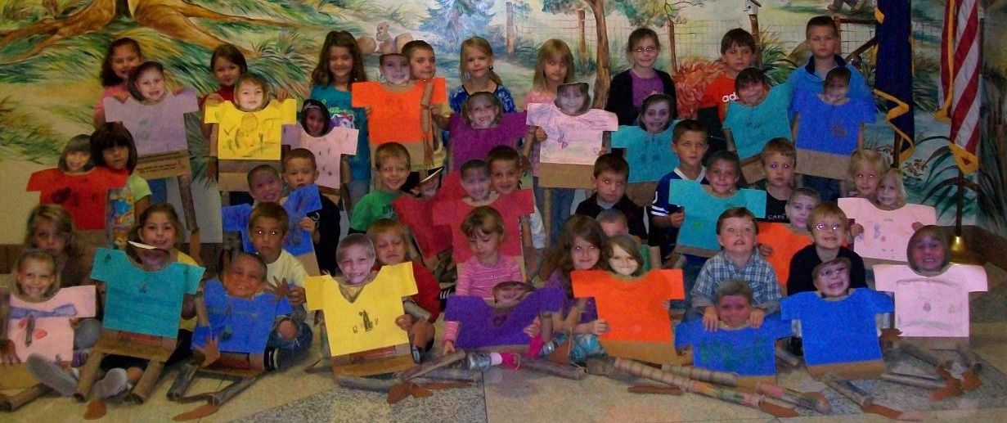
October 2011
Bag Buddies (2011)
Monday | Tuesday | Wednesday | Thursday | Friday
3) PTO Meeting @6:30 Natalee’s birthday was yesterday! Day 4 (No Special) | 4) White Day and Snack Day 5 (Music) | 5) Picture Day Bring your smile☺ Day 1 (Art) | 6) Day 2 (No Special) | 7) Gray Day and Snack Day 3 (Gym)
10) Book Fair Starts Day 4 (No Special) | 11) Day 5 (Music) | 12) Letter Mm snack Day 1 (Art) | 13) Day 2 (No Special) | 14) Special Adult Day 8:30-10:30 Day 3 (Gym)
17) Book Orders Due Letter Aa snack Day 4 (No Special) | 18) Day 5 (Music) | 19) Day 1 (Art) | 20) Letter Ss snack Day 2 (No Special) | 21) Field Trip (Autumn in the Country) End of 1st 9 weeks Day 3 (Gym)
24) Day 4 (No Special) | 25) Letter Pp snack Day 5 (Music) | 26) Day 1 (Art) | 27) Day 2 (No Special) | 28) Halloween Party 1:30-2:30 Grade Card’s Sent home Day 3 (Gym)

