Slide 1
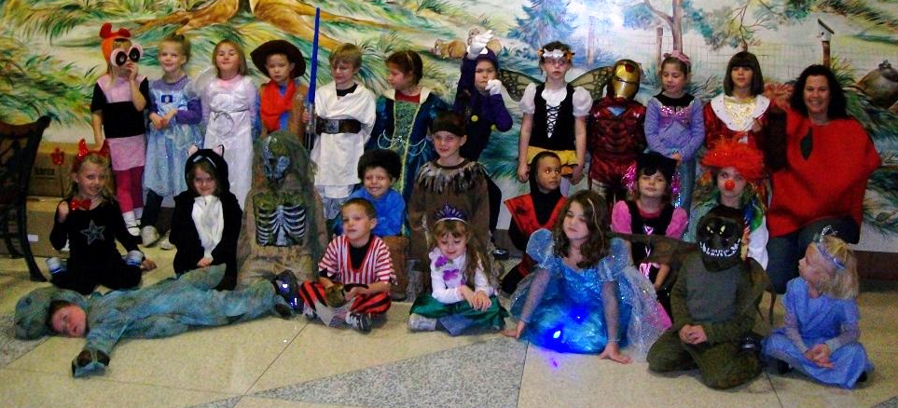
November 2011
Halloween 2011
Monday | Tuesday | Wednesday | Thursday | Friday
Day 4 (No Special) | Day 5 (Music) | Letter Tt snack Day 1 (Art) | Letter Ii Snack Day 2 (No Special) | Day 3 (Gym)
PTO Meeting 6:30pm Day 4 (No Special) | Letter Nn snack Day 5 (Music) | Day 1 (Art) | Day 2 (No Special) | November Family Project Due Letter Cc snack Day 3 (Gym)
Book Orders Due Day 4 (No Special) | Day 5 (Music) | Letter Oo snack Picture Retake Day Day 1 (Art) | Day 2 (No Special) | Day 3 (Gym)
Letter Ff snack Day 4 (No Special) | Making Muffins In the afternoon Day 5 (Music) | Midterms Go Home Stone Soup Thanksgiving Meal No Kid News Day 1 (Art) | No School Thanksgiving Break Happy Thanksgiving! | No School Thanksgiving Break Happy Thanksgiving!
Letter Hh snack Day 2 (No Special) | Day 3 (Gym) | Day 4 (No Special)
1
2
3
4
7
8
9
10
11
14
15
16
17
18
21
22
23
24
25
28
29
30

